Slide 1

Analysis of Airbnb Data
Vishnu Nair
ABADS
Batch 11

Slide 2


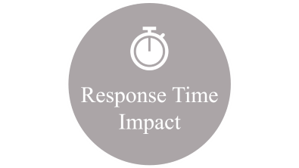



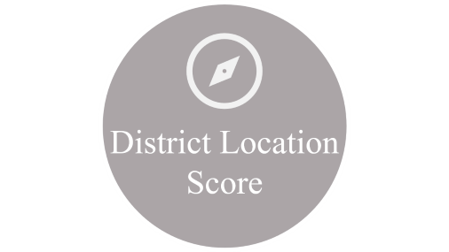
PROJECT GOALS

Slide 3

District Location Score

Slide 4


Location Score
City Location Score

Slide 5
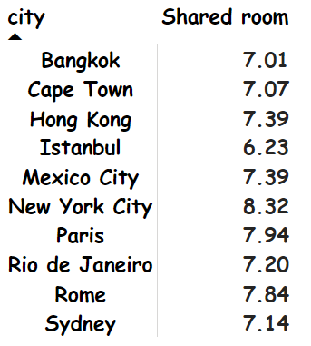
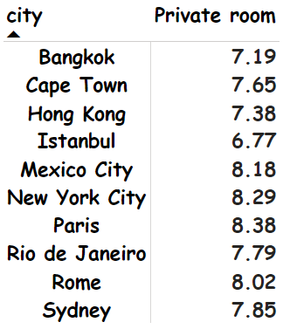
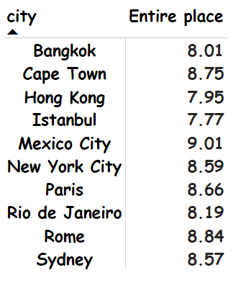
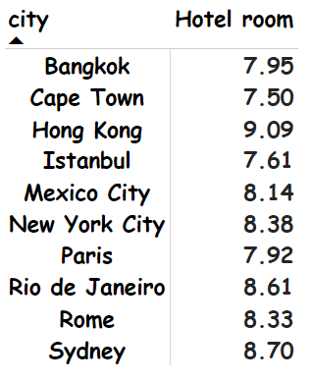
City Location Score
It can be concluded that Istanbul is the overall low performer based on average location scores across all the 4 types of rooms.
District Location Score

Slide 6
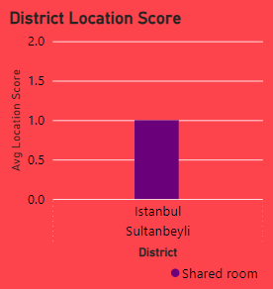
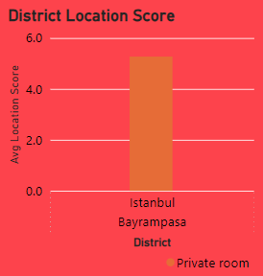
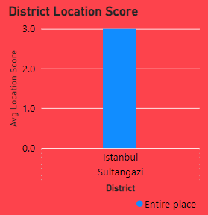
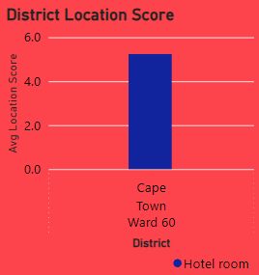
District Location Score
Shared Room
Private Room
Entire Place
Hotel Room
Sultanbeyli province in Istanbul ranked the lowest among the reviewers for Shared Room with an average score of 1/10.
Bayrampasa province in Istanbul ranked the lowest among the reviewers for Private Room with an average score of 5.27/10.
Sultangazi province in Istanbul ranked the lowest among the reviewers for Entire Place with an average score of 5.08/10.
Ward 60 province in Cape Town ranked the lowest among the reviewers for Hotel Room with an average score of 5.24/10.

Slide 7

Response Time Impact

Slide 8

Response Time Impact
Response Time Analysis

Slide 9

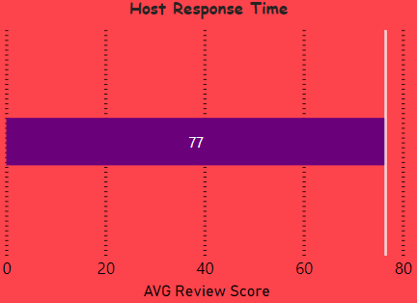
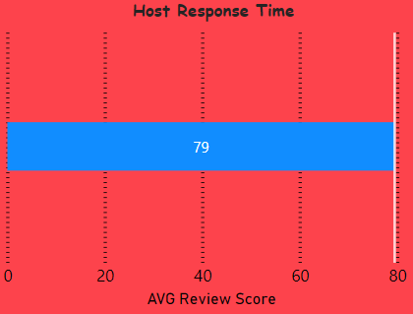
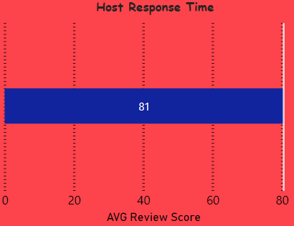
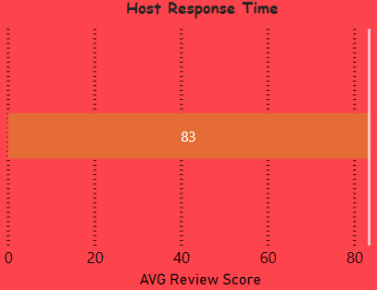
Response Time Analysis
Response time of few days or more fetched the score of 76.53/100
Response time of within a day fetched the score of 79.46/100
Response time of within a few hours fetched the score of 80.53/100
Response time of within an hour fetched the score of 83.46/100

Slide 10

Response Time Analysis
From the graphical analysis it can be concluded that the Host Response Time inversely proportional to Review Score by customers.
i.e as the time period of response increase the review score decreases & vice-versa.

Slide 11

Listing Price

Slide 12


Listing Price
The overall average price across 10 Cities & all the 4 major Room Types stands at $609 for one day.

Slide 13
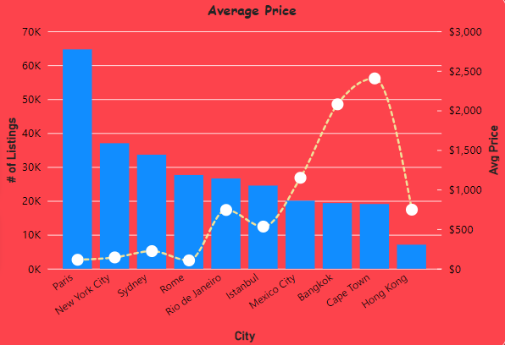
Listing Price
The dynamic fluctuations in listing numbers across diverse cities primarily drive the variations in the average listing price.
A city with 64,690 listings, Paris beckons at an average stay cost of $113, a serene choice amidst opulent Cape Town's luxurious average of $2405, influenced by its more exclusive 19,086 listings

Slide 14
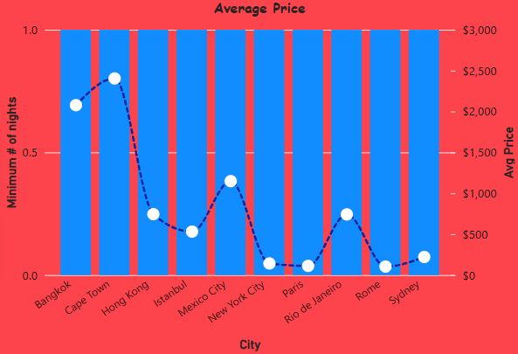
Listing Price
The foremost consideration when planning a vacation revolves around budget, a pivotal factor influencing the choice of destination.
When seeking affordable accommodations, Rome unveils the finest budget-friendly option at $105 per night, followed closely by Paris at $113 and New York at $142

Slide 15

Composite Score

Slide 16


Composite Score
The seamless check-in experience for guests hinges directly on the quality of communication with the host, a pivotal factor shaping the overall score

Slide 17
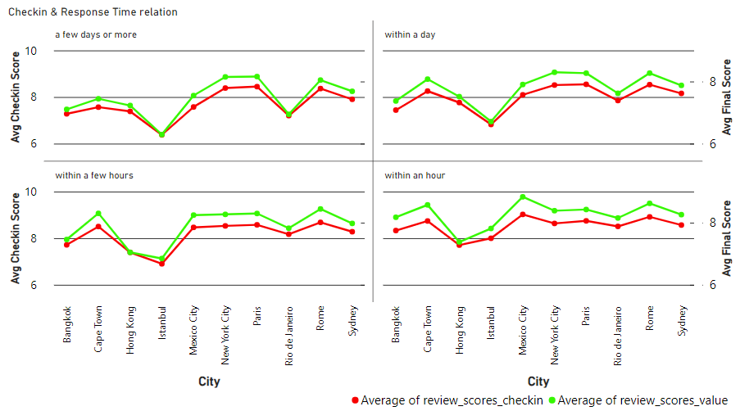
Composite Score
In cities such as Mexico, Istanbul, and Bangkok, a swift host response directly translates into superior check-in experiences and overall ratings, yet in cities like Cape Town, New York City, and Paris, its impact remains minimal or negligible

Slide 18

Hosting Experience

Slide 19


Hosting Experience
Analyzing Host who have completed 10Yrs

Slide 20
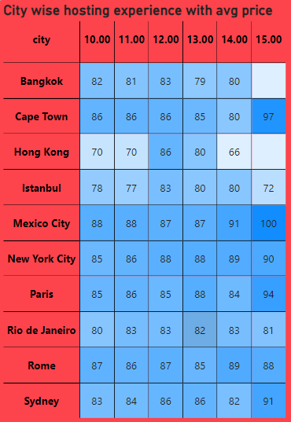
Hosting Experience
The tabulated data elegantly suggests a prevailing trend: an inclination towards higher review scores bestowed upon hosts boasting a decade or more of seasoned expertise.

Slide 21
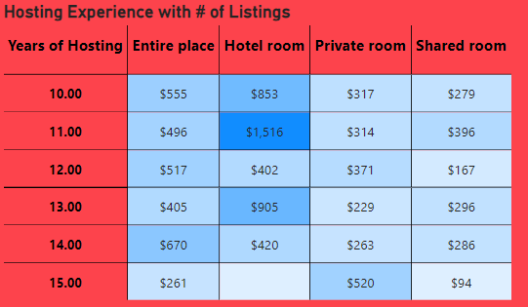
Hosting Experience
Despite the wealth of hosting experience exceeding a decade, there remains an intriguing paradox: the average price stands notably lower, painting a curious picture within the landscape of hospitality economics.

Slide 22

Property Price Analysis

Slide 23


Property Price Analysis
Avg Price of Property
Hotel Room
$800
Entire Place
$673
Shared Room
$579
Private Room
$462

Slide 24
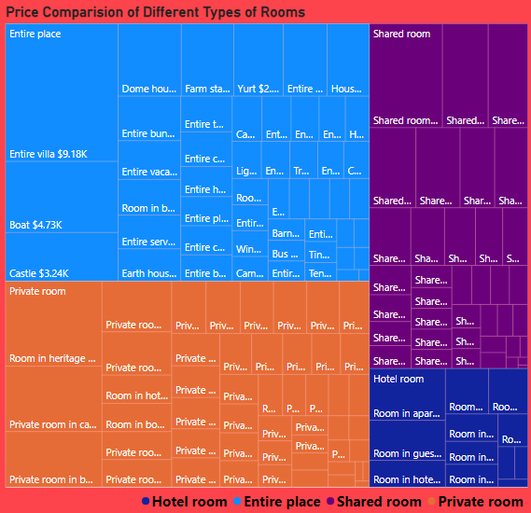
Property Price Analysis
The property type stands as a significant determinant shaping the price
The captivating tree map unveils 'Entire Villa,' ‘Boat,’ ,’Room in heritage hotel ‘ and ‘Shared room in parking space' as the regal property types commanding the loftiest average prices for entire accommodations.
Entire Villa = $9,180
Boat = $4,730
Rooms in heritage hotel = $4,850
Shared room in parking space = $4,496

Slide 25

Insights Report

Slide 26


Insights Report
Delving deeper into the intricate web of influences—be it ratings, prices, country of stay, room types, or beyond—unravels the intricate tapestry defining the Airbnb experience.

Slide 27
Insights Report
Review Biased Insights
A mere dip of 16.1 points in the review score heralds a staggering rise, steering the average price beyond the remarkable threshold of $7,950.
With an average hosting tenure of merely 3 years, a palpable decline of 14.6 points ensues in the average review score, painting a nuanced correlation between experience and perception.
In the realm of cities, Istanbul casts a distinctive hue, marking a downturn of 10.4 points in the average review score, hinting at its unique narrative within the tapestry of experiences.

Slide 28
Insights Report
Price Biased Insights
Amidst the grandeur of destinations, Rome's allure unveils a gentle descent, marking a reduction of $780 in the average price, painting a compelling narrative within the realms of affordability.
Amidst the delicate dance of pricing, a mere descent of nearly $20 unfolds a crescendo, ushering in a noteworthy ascent of 6.9 points in the review score, painting an eloquent tale of value and perception.

Slide 29
Insights Report
Type of Room Biased Insights
In the realm of pricing majesty, a realm surpassing $800 unveils a subtle rise, elevating the odds of an Entire Place as the preferred room type by a delicate 1.2%, crafting a narrative of opulence in choice
In the enchanting tapestry of cities, Bangkok's essence weaves a compelling tale, elevating the likelihood of a Hotel Room choice by a mesmerizing 2.65%, a narrative echoing the city's unique allure in accommodation preferences.
Amidst the realm of affordability, where the average price tenderly touches $28 or less, the allure of a Shared Room ascends enchantingly, embracing a notable increase of 9.28%, painting a narrative woven with affordability and communal charm.

Slide 30
Thank You

